Slide 1

GROUP C
Baldoni V., Boffa M., Fabiani F.,
Lanza C., Ravera A.
Master course in ICT for Smart Societies – Interdisciplinary Project Supervisor : Giacomo Chiesa

Slide 2

Effect of urbanistic action on social perspective
Master course in ICT for Smart Societies – Interdisciplinary Project Supervisor : Giacomo Chiesa

Slide 3
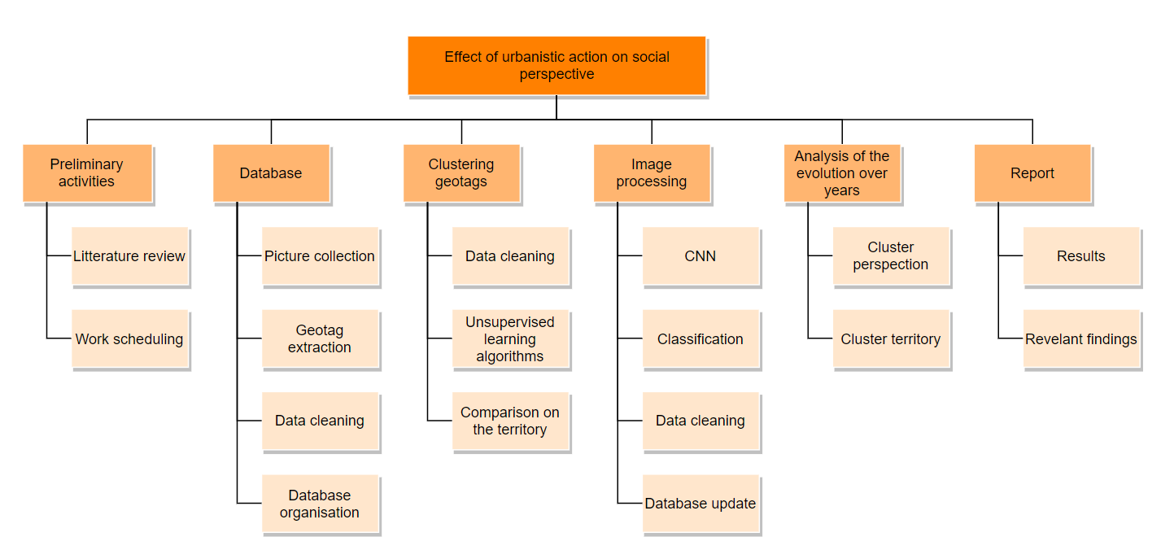
WORK PLAN
DONE
DONE
DONE
WIP
WIP
V
F
A
DONE
DONE
DONE
WIP
WIP
C
M
DONE
DONE
WIP
Chiara
Arianna
Matteo
Vincenzo
Federico
C
DONE
WIP
A
M
V
F

Slide 4









Critical Design Review (CDR)
dropboxAPI
dropboxAPI
instaloader
flickrapi
pymongo
pymongo
.csv
CDR
Analysis of the clusters
ImagNet labels

Slide 5

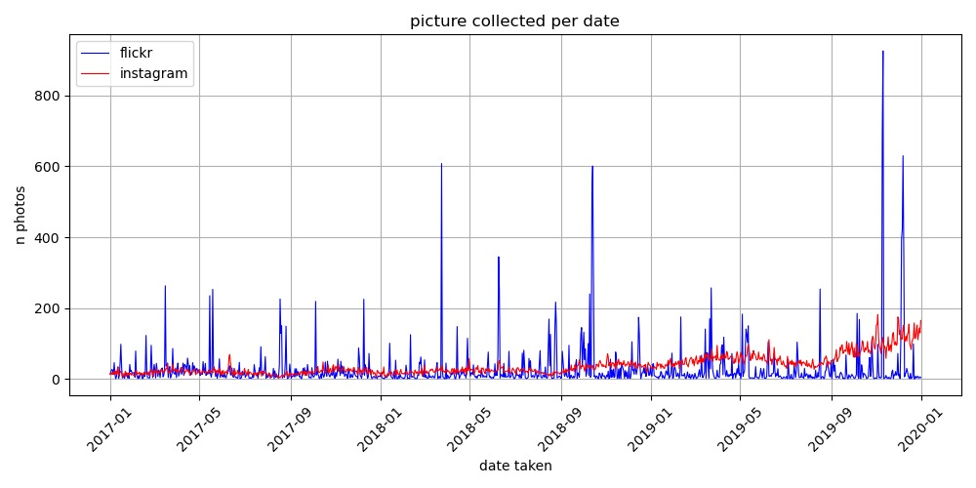

Critical Design Review (CDR)
2017 | 8210 | 7121
2018 | 9844 | 9696
2019 | 10607 | 24294
TOTAL | 28661 | 41111

Slide 6
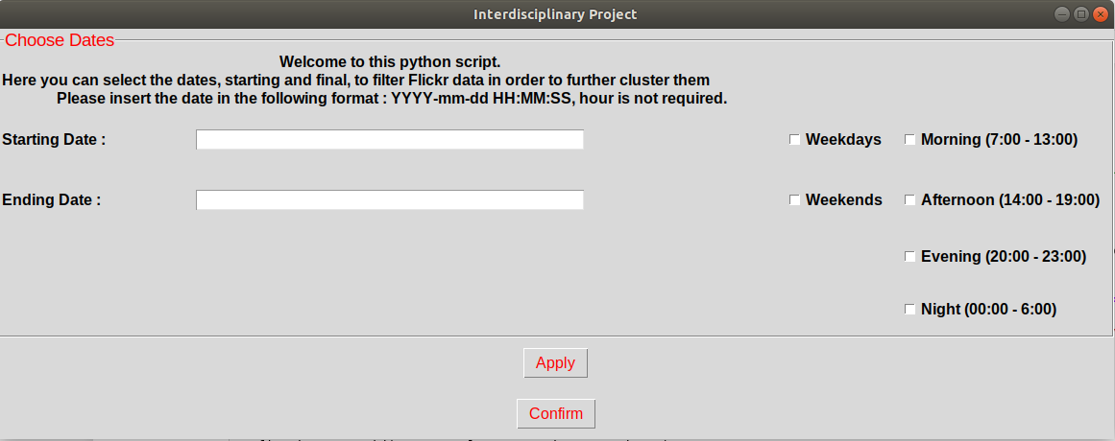
Critical Design Review (CDR)
Tkinter
GUI to select dates for filtering Flickr Data coming from MongoDB

Slide 7
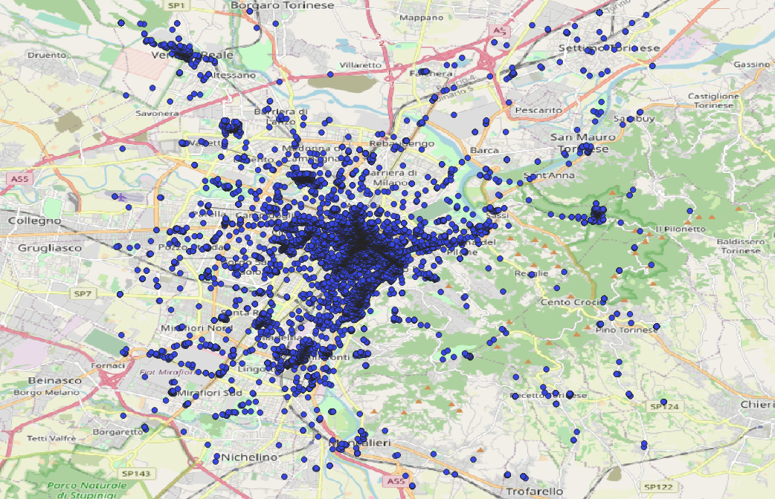
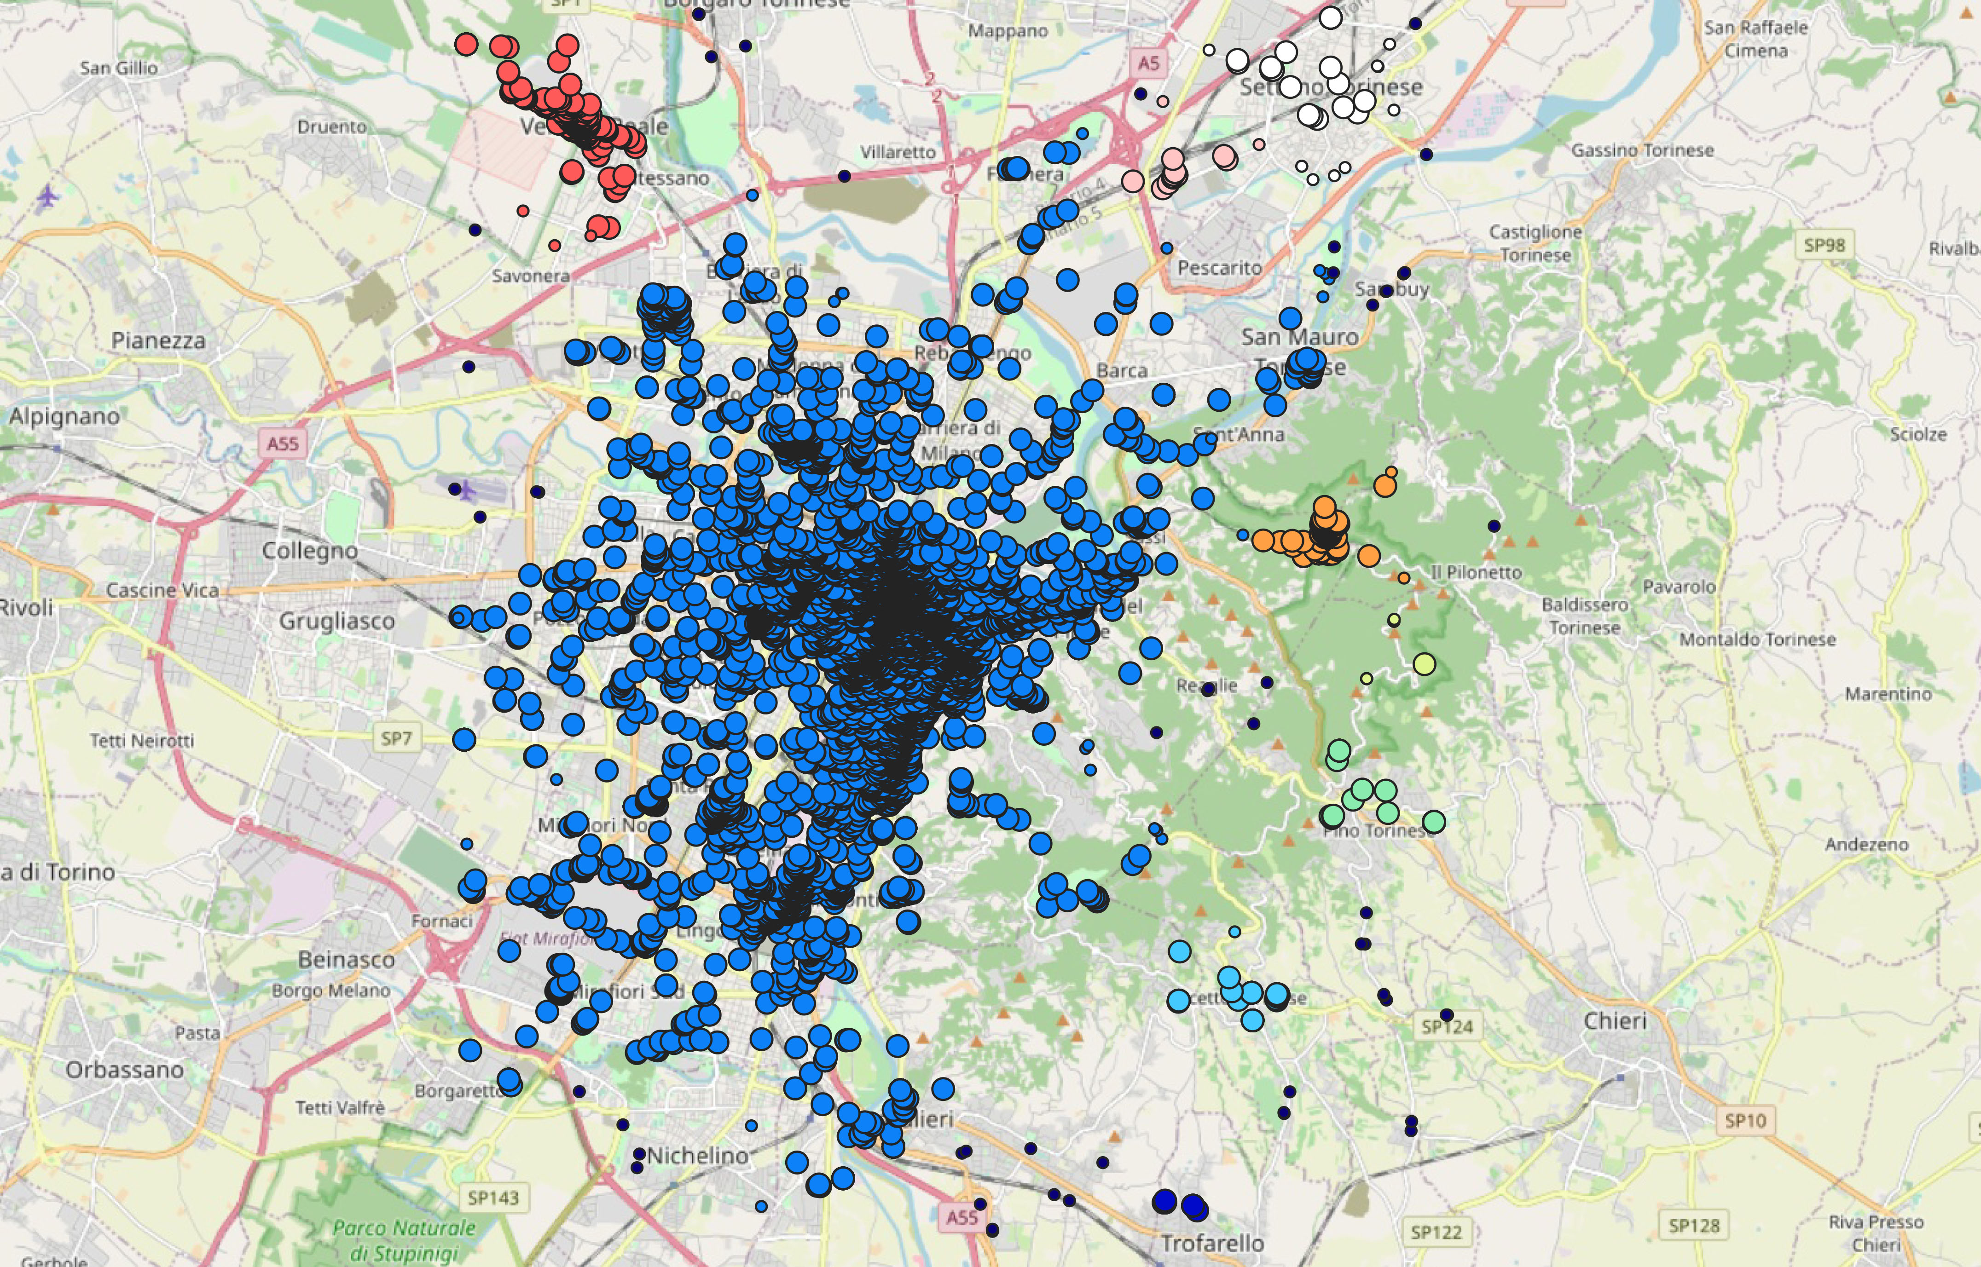
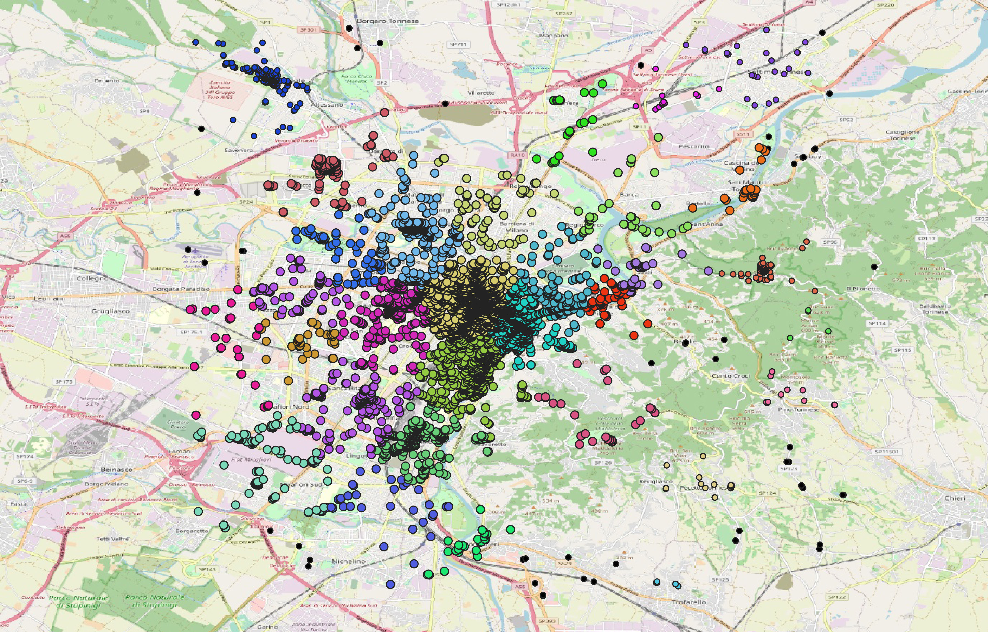
Critical Design Review (CDR)
Db scan
K-means + DBSCAN

Slide 8
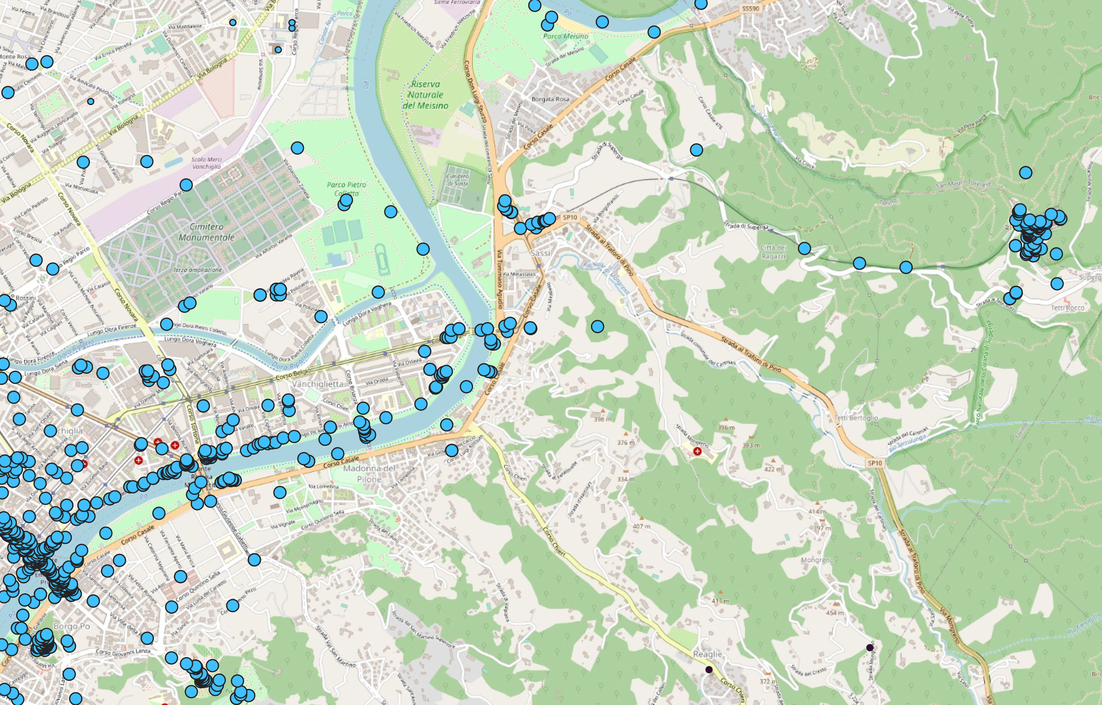
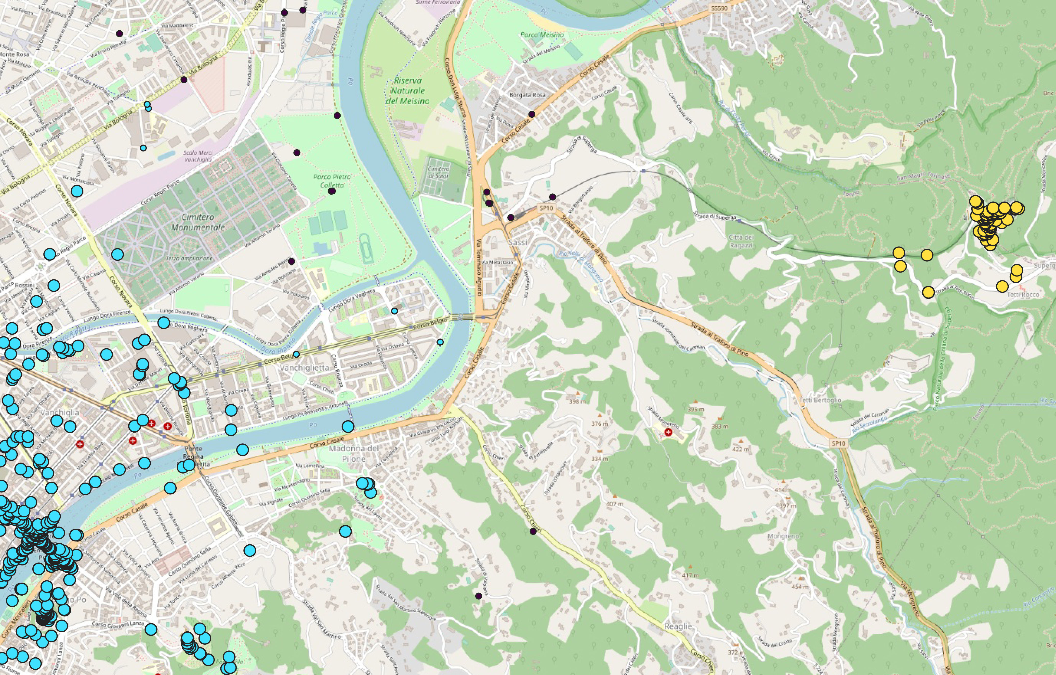
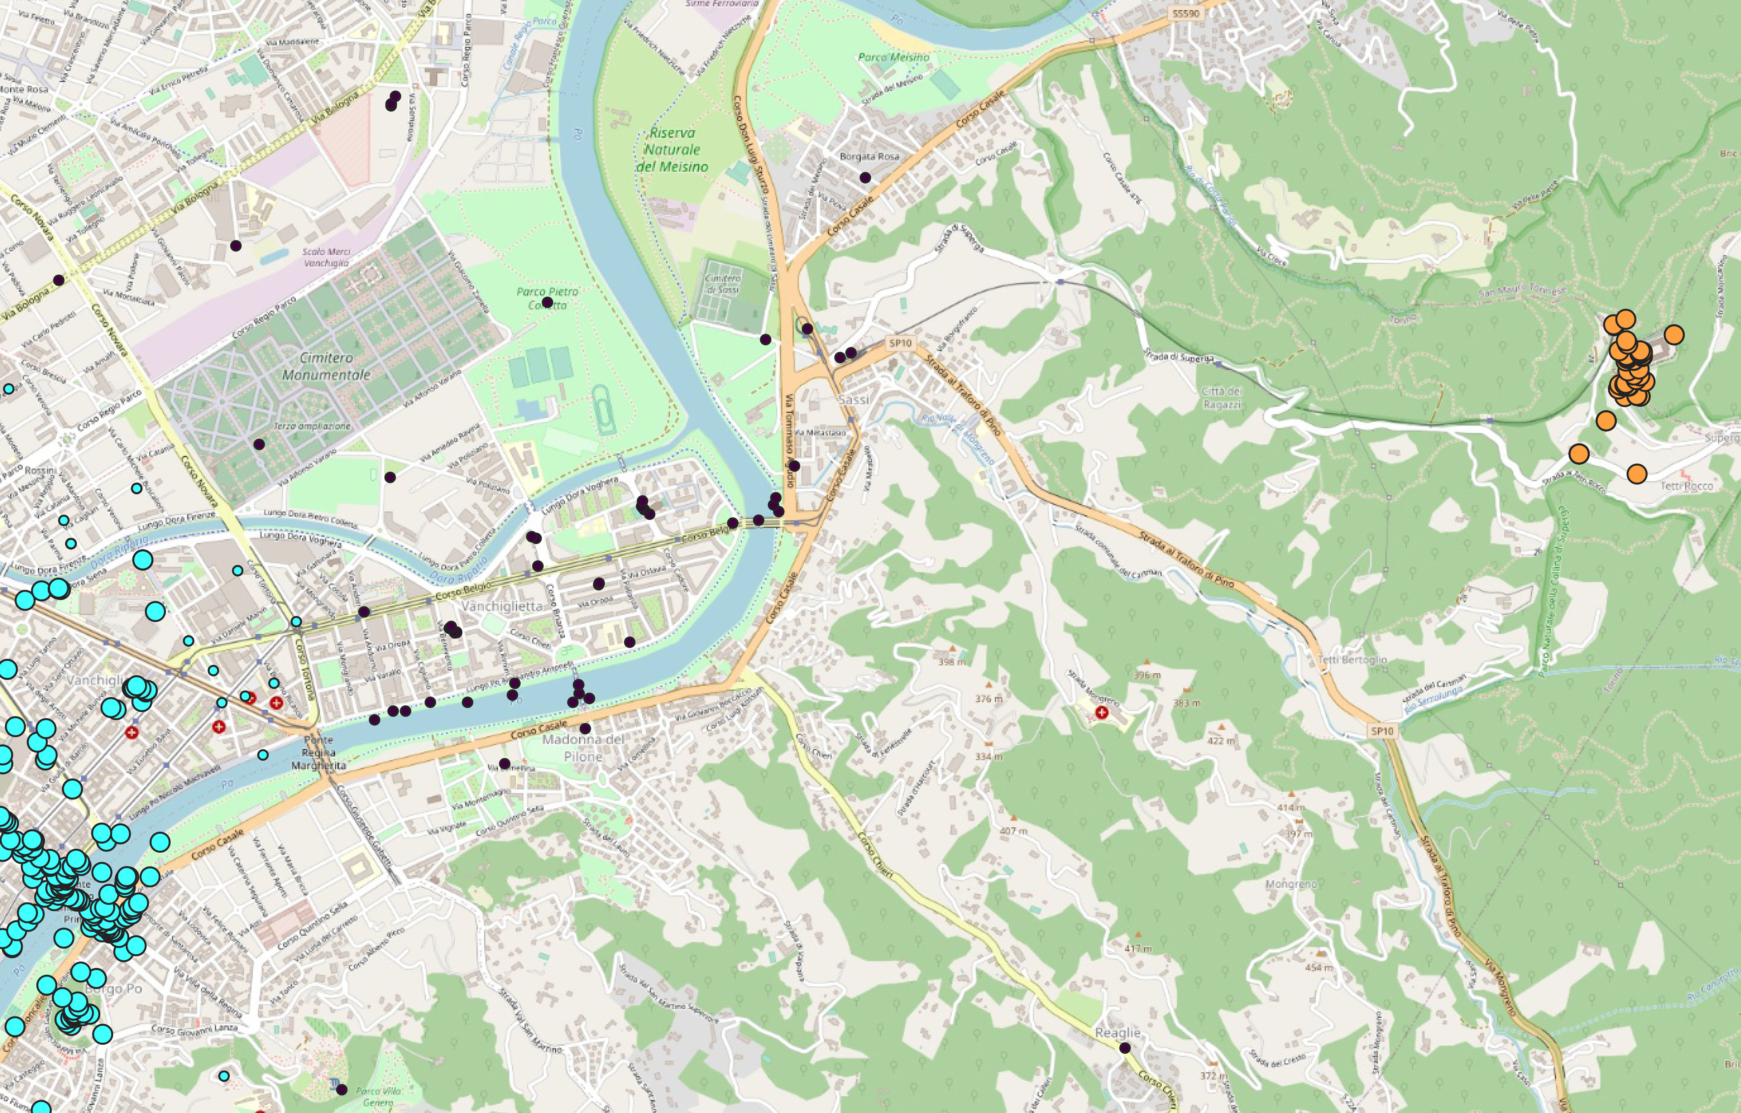
Critical Design Review (CDR)
2017
2018
2019

Slide 9
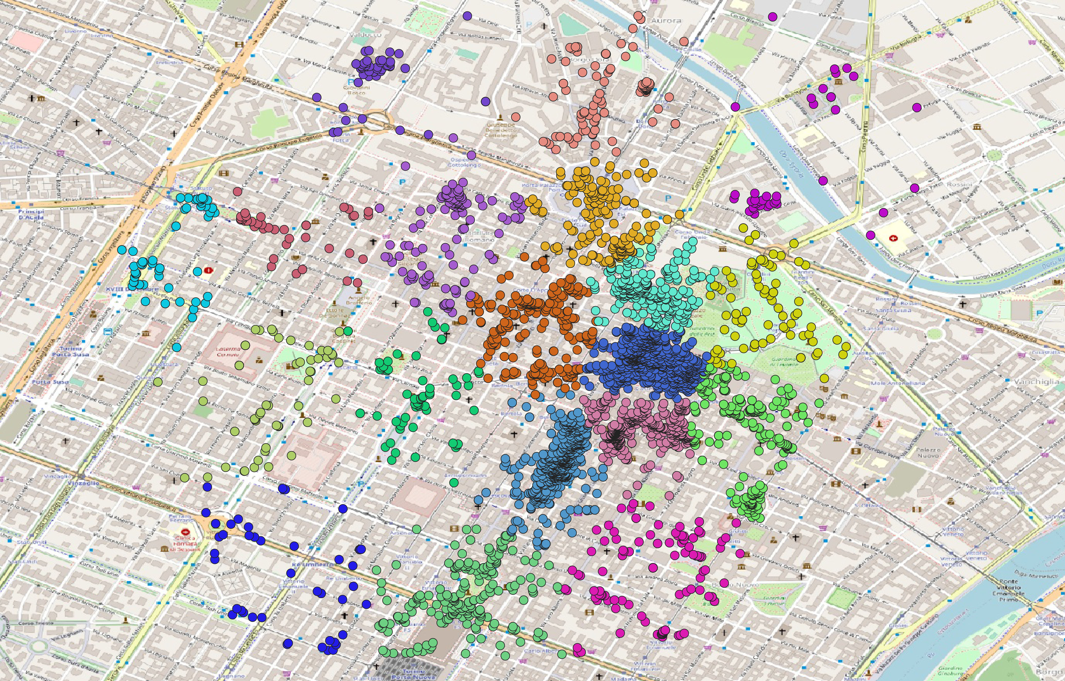
Critical Design Review (CDR)
City center

Slide 10
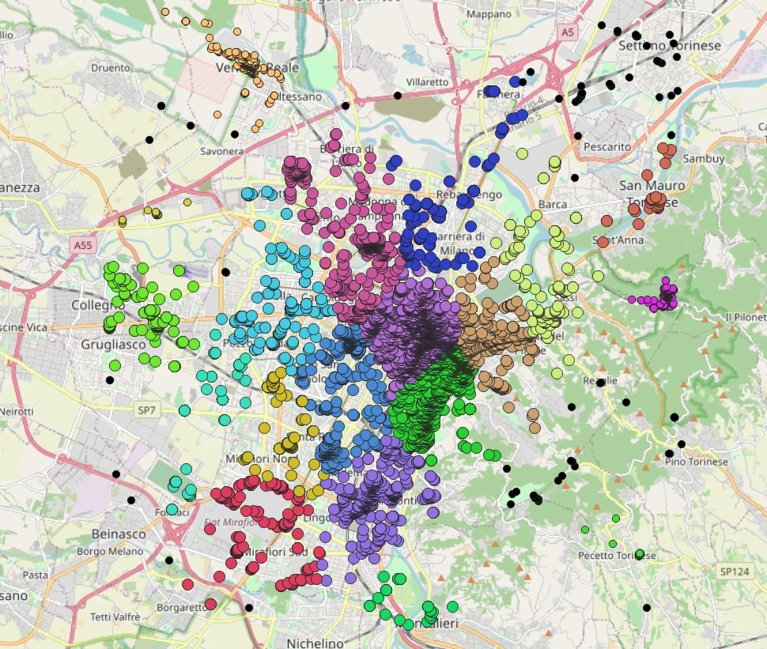
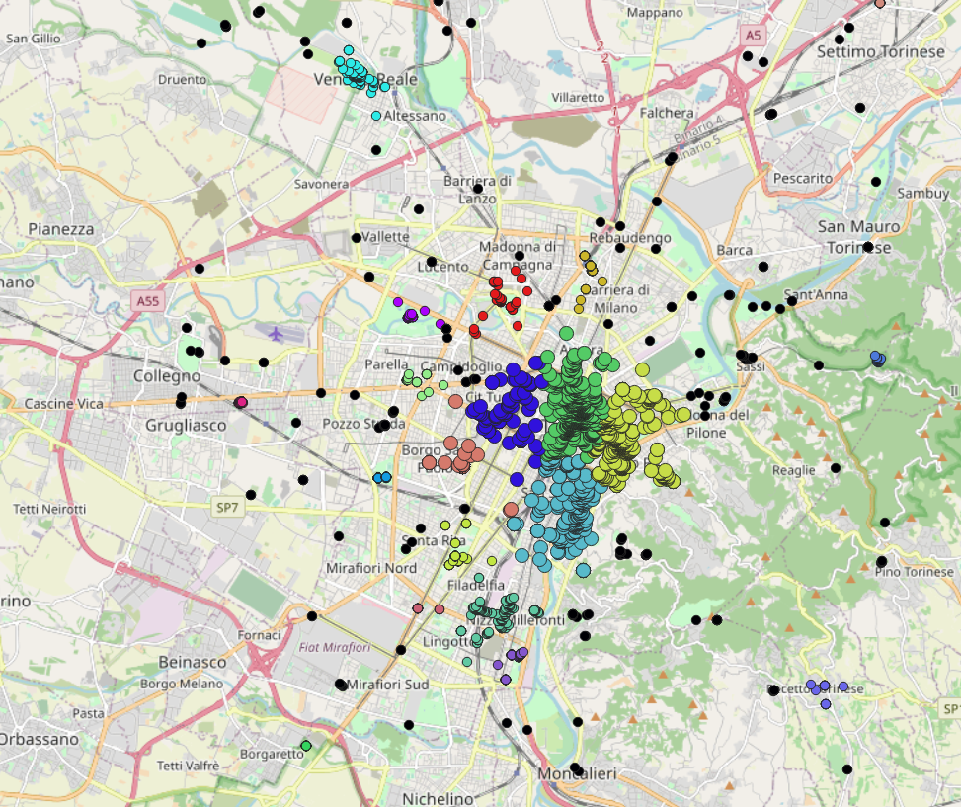
Critical Design Review (CDR)
Week days
Weekends

Slide 11

Critical Design Review (CDR)
Work without prior → flexible : no constraints on Turin nor in the period
Weakness → there are not enough data for a punctual analysis
(Of course we know Turin so we can compare a posteriori the results)
i.e.

Slide 12
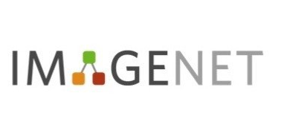

Critical Design Review (CDR)
Image Processing
Pre-trained Convolutional Neural Network : Inception-v3
a widely-used image recognition model that has been shown to attain greater than 78.1% accuracy on the ImageNet dataset.

Slide 13
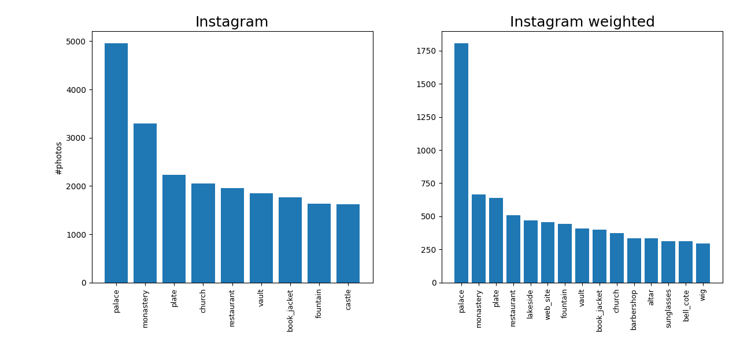
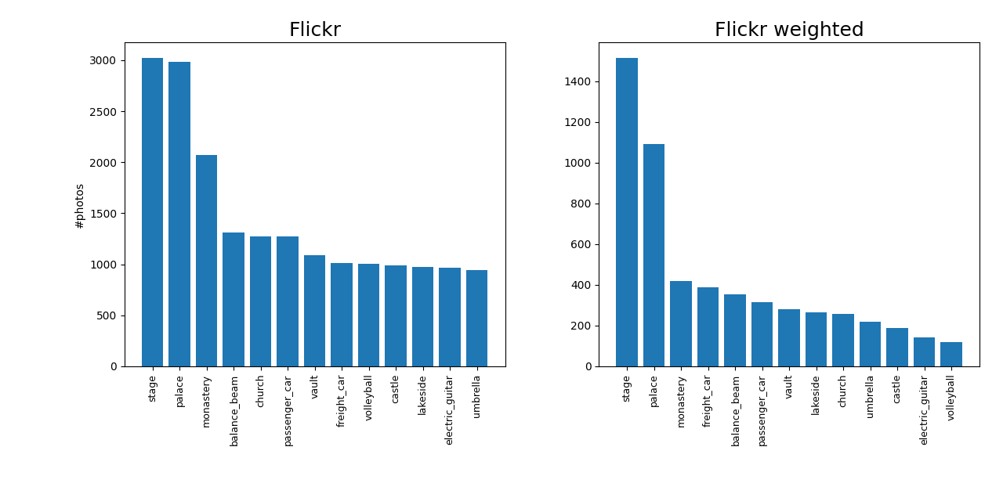
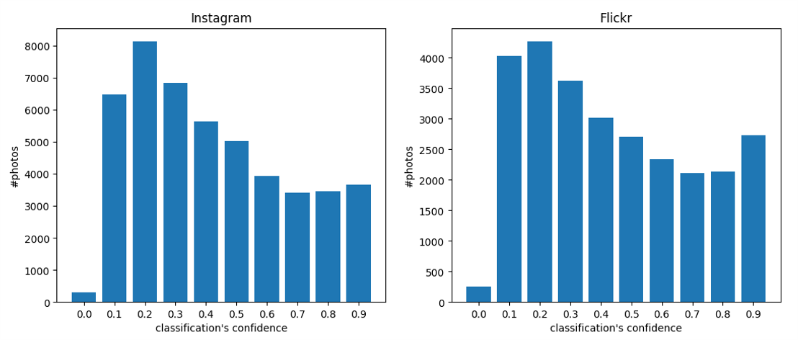
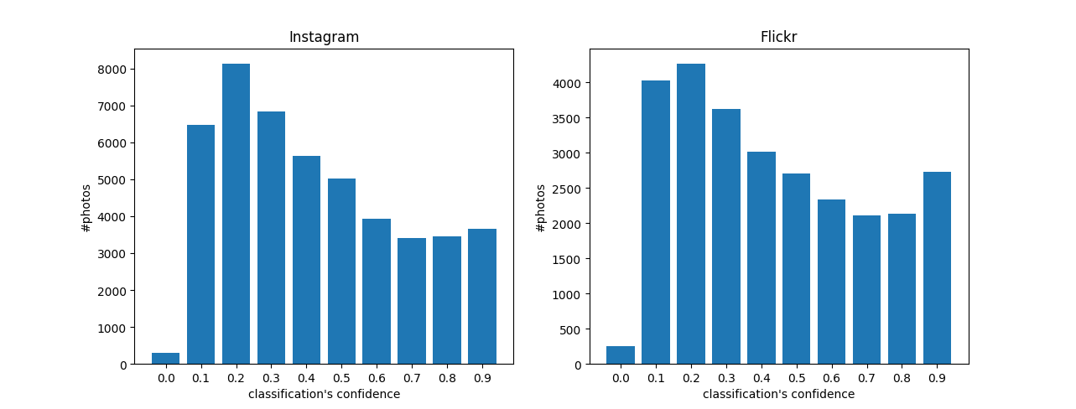
Critical Design Review (CDR)

Slide 14
Critical Design Review (CDR)

Slide 15
Critical Design Review (CDR)

Slide 16
Critical Design Review (CDR)
PRIMARY CLASSES
Food | Religion
Natural view and flora | Residence
Animals | Entertainment
Shopping/shops/clothing and merchandising | Palaces/historical monuments/cultural properties
Transportation | Facilities
Urban scape | People
Exhibits/sculptures/Museums | Objects/miscellaneous

Slide 17
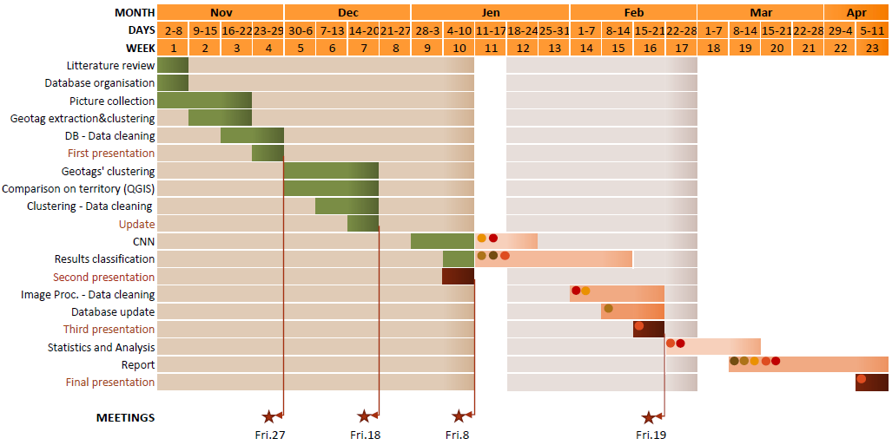
GANTT

Slide 18
THANK YOU for the attention

